Slide 1
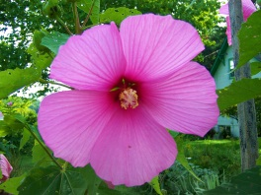
W
E
L
C
O
M
E

Slide 2
Note for the honourable teachers:
The subject teachers are requested to read the notes given below the slides.
Notes are given bellow the slide no. 5, 7, 8, 11, 12, 13, 14, 15, 18,19 and 22 .
This content may be too long as lesson’s activities are many. If it is too long, it can be taken in two periods.

Slide 3
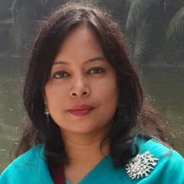
INTRODUCTION
ROUFUN NAHAR
ASSISTANT TEACHER ( ENGLISH)
MAZIDA GOVT. HIGH SCHOOL
TONGI, GAZIPUR
CLASS: SIX
SUBJECT: ENGLISH SECOND PAPER
UNIT: ONE
LESSON: ELEVEN
TOPIC: PARTS OF SPEECH (Adverb)

Slide 4
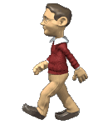
Look at the pictures and answer the questions.
What is the old man doing?
What is the man doing?
The old man is walking.
The man is walking.
How is the old man walking?
How is the man walking?
The old man is walking slowly.
The man is walking quickly.

Slide 5
The old man is walking slowly.
Adjective
Noun
Verb
Can you tell which one is adjective in this sentence?
Can you tell which one is noun in this sentence?
Can you tell which ones are verbs in this sentence?
Can you tell the name of the parts of speech of the word “ slowly”?
Adverb
Notes:
The students may be able to give the answer of the last question or may not be able. The teacher can explain what is adverb.

Slide 6
LEARNING OUTCOMES OF THE LESSON
By the end of the lesson the students will be able to
identify adverbs.
make sentences with adverbs.
Use suitable adverbs in sentences.
write about a person using adverbs.

Slide 7
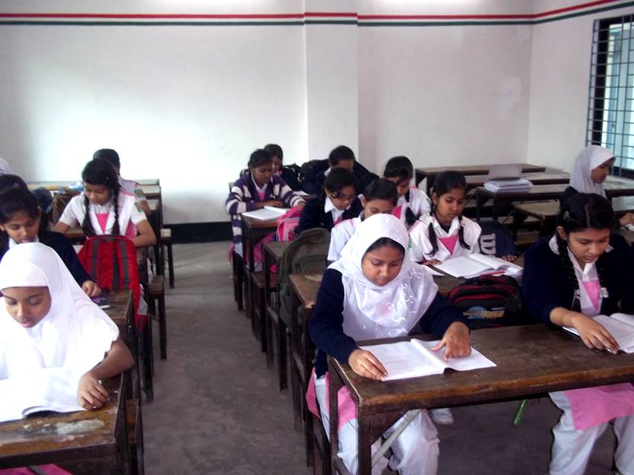
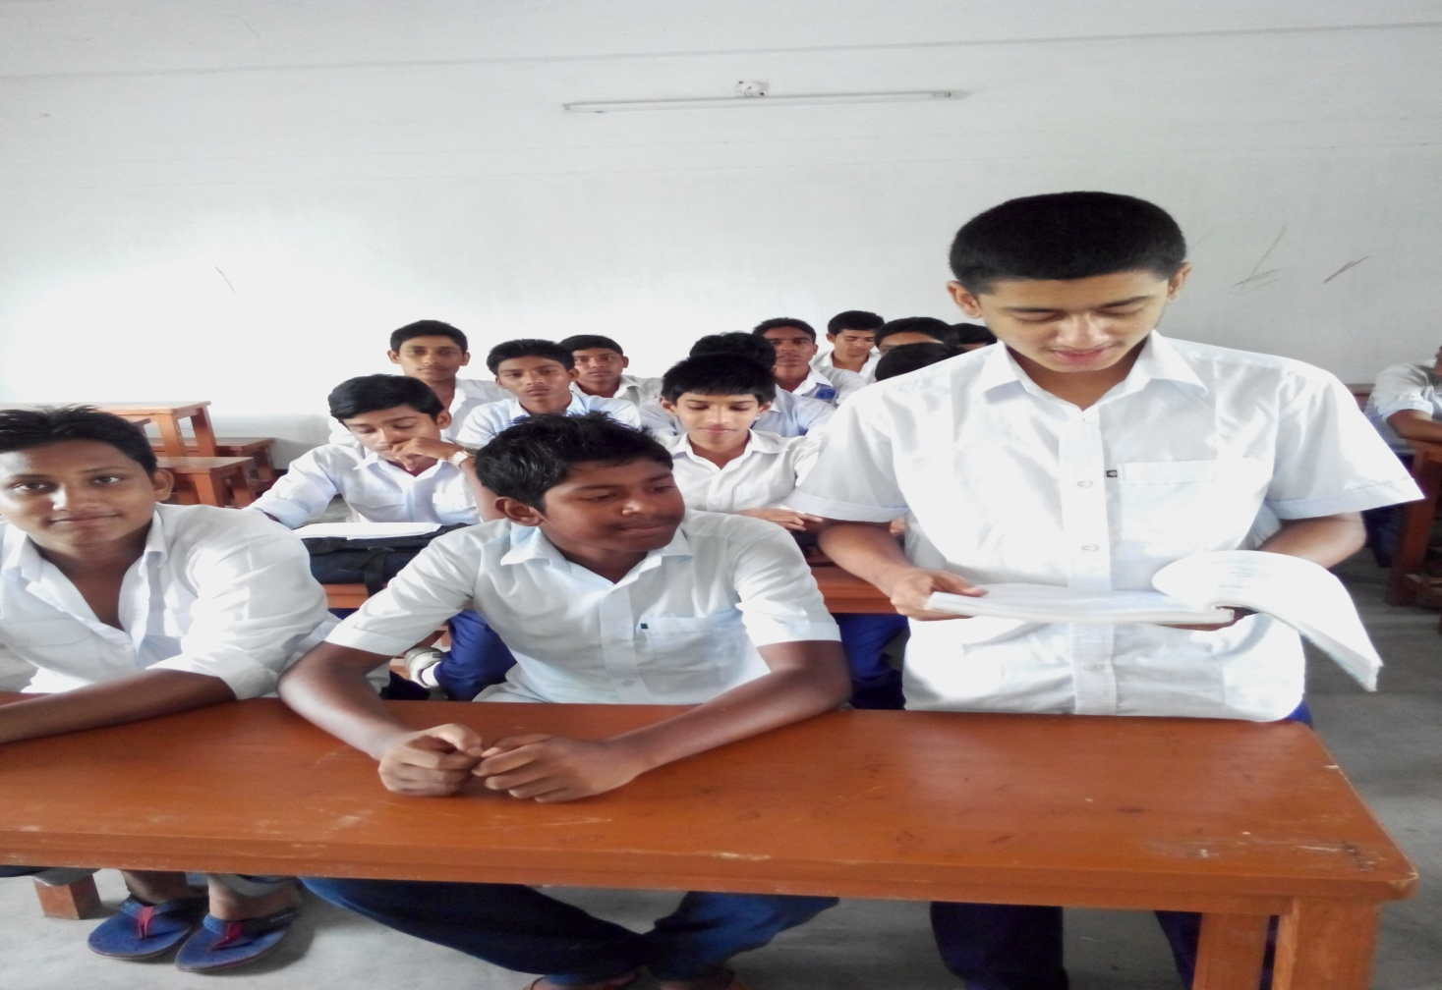
Look at the pictures. Give the answers of the following questions in full sentence.
How are the girls reading their English for Today book?
How is the boy reading their English for Today book?
The girls are reading their English for Today book silently.
The boy is reading their English for Today book loudly.
Notes:
The students will answer in a full sentence. They will give answer orally.

Slide 8
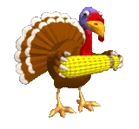
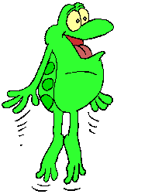
Look at the pictures. Can you answer the following questions? Give the answer in full sentence. Clues are given below.
How is the chicken eating?
How is the frog jumping?
Answer
Answer
The chicken is eating slowly.
The frog is jumping quickly.
quickly
slowly
Notes:
The students will answer in a full sentence. They will give answer orally.

Slide 9
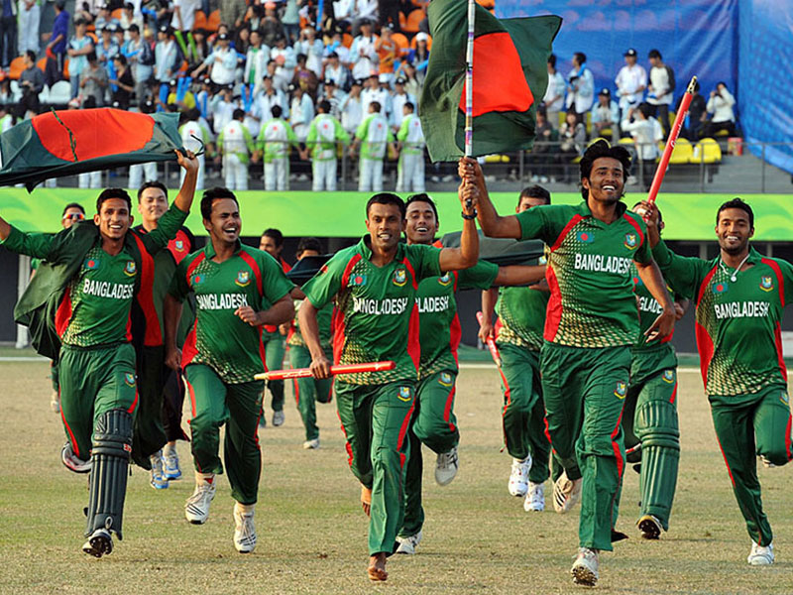
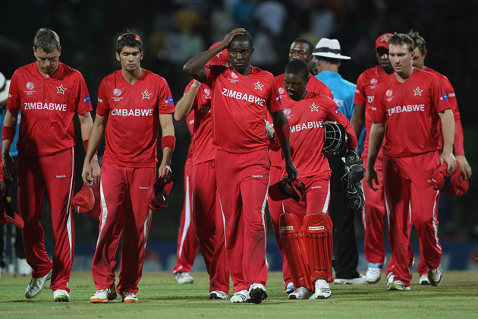
Look at the pictures. Give the answers of the following questions in full sentence.
How is the team celebrating the victory ?
How is the team leaving the field?
The team is celebrating the victory cheerfully/ happily/delightfully.
The team is leaving the field sadly / sorrowfully.

Slide 10
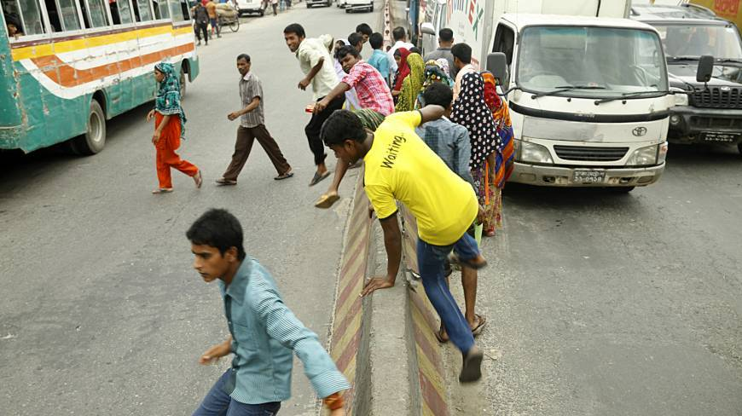
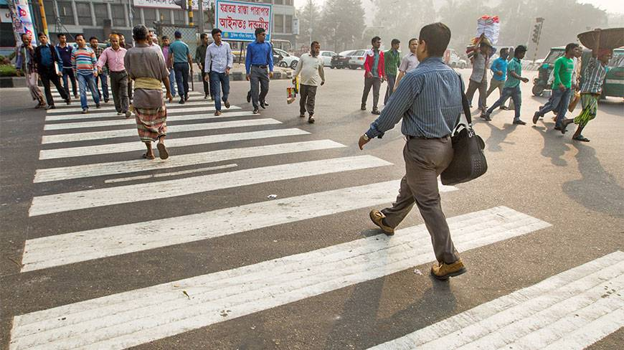
Look at the pictures. Can you answer the following questions? Give the answer in full sentence. Clues are given below.
1. How are the people crossing the road?
2. How are the people crossing the road?
Answer
Answer
The people are crossing the road unsafely.
The people are crossing the road safely.
safely
unsafely

Slide 11
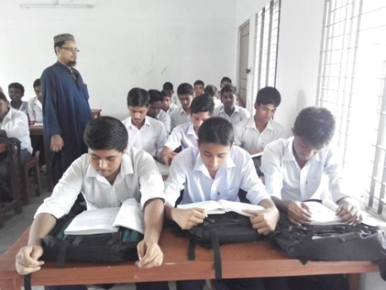
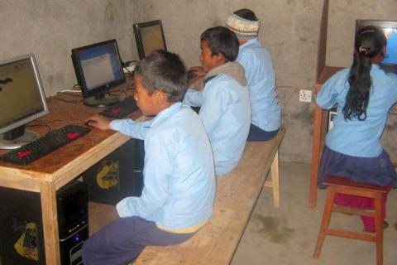
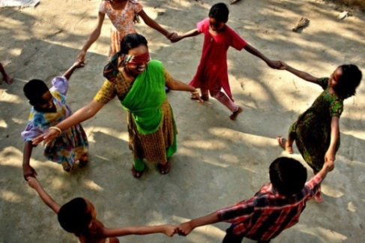
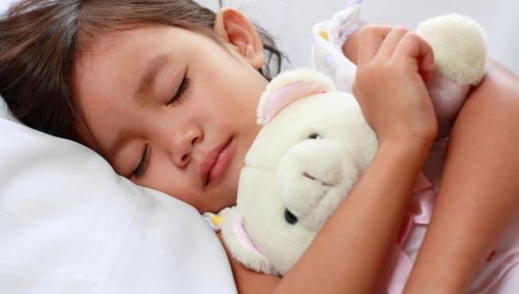
Look at the pictures and write the answers of the following questions. Clues are given in the box.
1. How are the students reading?
Answer
The students are reading silently.
2. How are the students learning computers?
Answer
The students are learning computers eagerly.
happily
3. How are they playing?
silently
Answer
They are playing happily.
eagerly
comfortably
4. How is the girl sleeping?
Answer
The girl is sleeping comfortably.
Notes:
Teacher can elicit answers from 2/3 students.

Slide 12
The frog is jumping quickly.
Can you tell which word is modified by the word “ quickly”?
Here the word ‘quickly’ modifies the verb ‘jump’ .
An adverb describes or modifies or qualifies a verb.
Here the word quickly is adverb .
Can you give another example on your own?
Notes:
Teacher can explain the adverb using more examples. She/he can also use board.

Slide 13
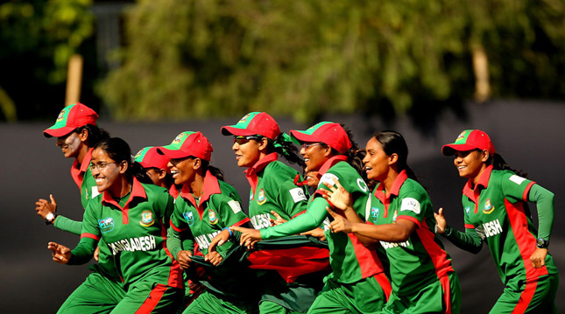
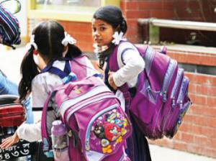
Look at the pictures. Give the answers of the following questions in full sentence.
How happy are the players?
How heavy are the bags for the girls?
The players are very happy.
The bags are very/too heavy for the girls .
Notes:
The students will answer in a full sentence. They will give answer orally.

Slide 14
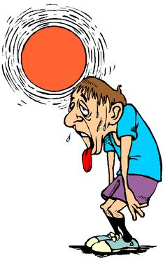
Look at the picture. Give the answers of the following question in full sentence.
How hot is the day?
The day is extremely/very hot .
Notes:
Teacher can clarify the meaning of ‘extremely’.

Slide 15
They are very happy.
Can you tell which word is modified by the word “ very”?
Here the word ‘very’ modifies the adjective ‘happy’ .
An adverb modifies or describes or qualifies an adjective.
Here the word “very” is adverb .
Can you give another example on your own?
Notes:
Teacher can explain the adverb using more examples. She/he can also use board.

Slide 16
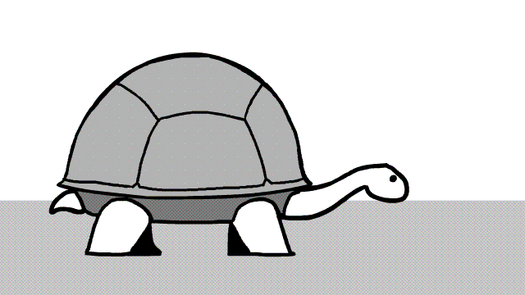
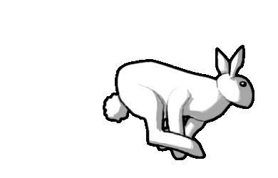
Look at the pictures Can you answer the following questions? Give the answer in full sentence. Clue is given below.
How slowly is the tortoise moving?
How quickly is the rabbit running?
Answer
Answer
The tortoise is moving very slowly.
The rabbit is running very quickly.
very

Slide 17
The rabbit is running so quickly.
Can you tell which word is modified by the word “ so”?
Here the word ‘so’ modifies the adjective ‘quickly’ .
An adverb modifies or describes or qualifies an adverb.
Here the word “so” is adverb .
Can you give another example on your own?
Adverb is a word or phrase that modifies or qualifies a verb, an adjective, or other adverb .
Notes:
Teacher can explain the adverb using more examples. She/he can also use board.

Slide 18
Note: Most adverbs are made by adding ly to the adjectives .
Adjective | Adverb
silent | silently
happy | happily
Look at the adjective ‘happy’ and adverb ‘happily’. When the adjective ends with y, the y is changed into i and add ly to the adjectives .
Notes:
Teacher can explain the adverb using more examples. She/he can also use board.

Slide 19
Note: Some words can be used as both an adjective or a adverb.
Adjective | Adverb
hard | hard
fast | fast
late | late
See the examples .
Adjective | Adverb
The stone is hard. | She works hard.
The stone is hard.
Here the word ‘hard’ modifies or describes the noun ‘stone’. So the word ‘hard’ is adjective here.
She works hard.
Here the word ‘hard’ modifies or describes the verb ‘works’. So the word ‘hard’ is adverb here.
Notes:
Teacher can explain the adverb using more examples. She/he can also use board.

Slide 20
Pair work
Read the following passage and find out the adverbs from it.
Anik Islam is a very good student. He studies his lessons attentively. He behaves gently with everybody. He sings well. His school is Mozida Govt. High School. It is so big school. He loves his school very much.
very
attentively
gently
well
so
very
much
Answer

Slide 21
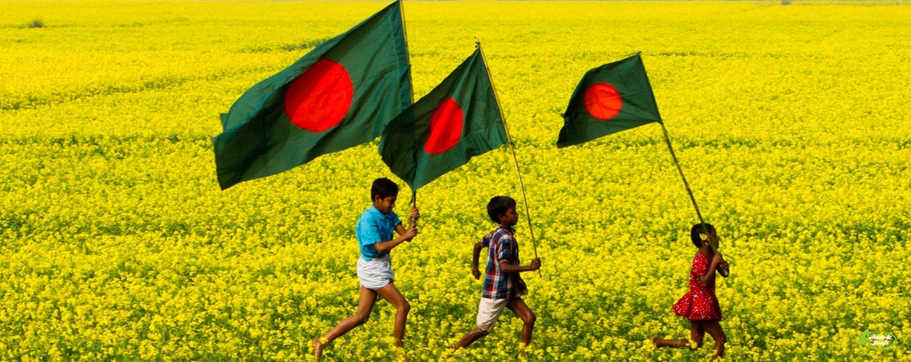
Pair work
Read the following passage and fill the gaps with the suitable adverbs from the box.
The boys and the girl are running __________. They are holding the flags _______. They are going ______. The field is ____ beautiful. It is ______ yellow. They are enjoying _____ much.
delightfully
tightly
straight
so
quite
very
straight
quite
tightly
very
delightfully
so

Slide 22
Think about your friend and write the answers of the following questions about your friend. Clues are given below.
1. How good is your friend?
2. How meritorious is she/he?
3. How gentle is she/he?
4. How kind is she/he to the poor?
5. How quickly can she/he run?
6. How much does she/he love her/his parents?
very, so, quite, extremely, slightly
Notes:
Answer may vary here. Teacher can elicit answers from 2/3 students.

Slide 23
Home work
Write about your daily activities using adverbs. (Not more than 10 lines)

Slide 24
Acknowledgement
MoE, DSHE, NCTB & A2I respective of officials
And the editors panel: Ranjit Poddar, Associate Professor (English) TTC, Dhaka, Md. Jahangir Hasan (English), Assistant Professor TTC, Rangpur and Urmila Khaled Assistant Professor (English) TTC, Dhaka.
Their direction, valuable suggestions and intensive supervision have enriched the model contents.

Slide 25
THANK YOU ALL

